Slide 1

Telling the time
Lets learn about telling the time…

Slide 2

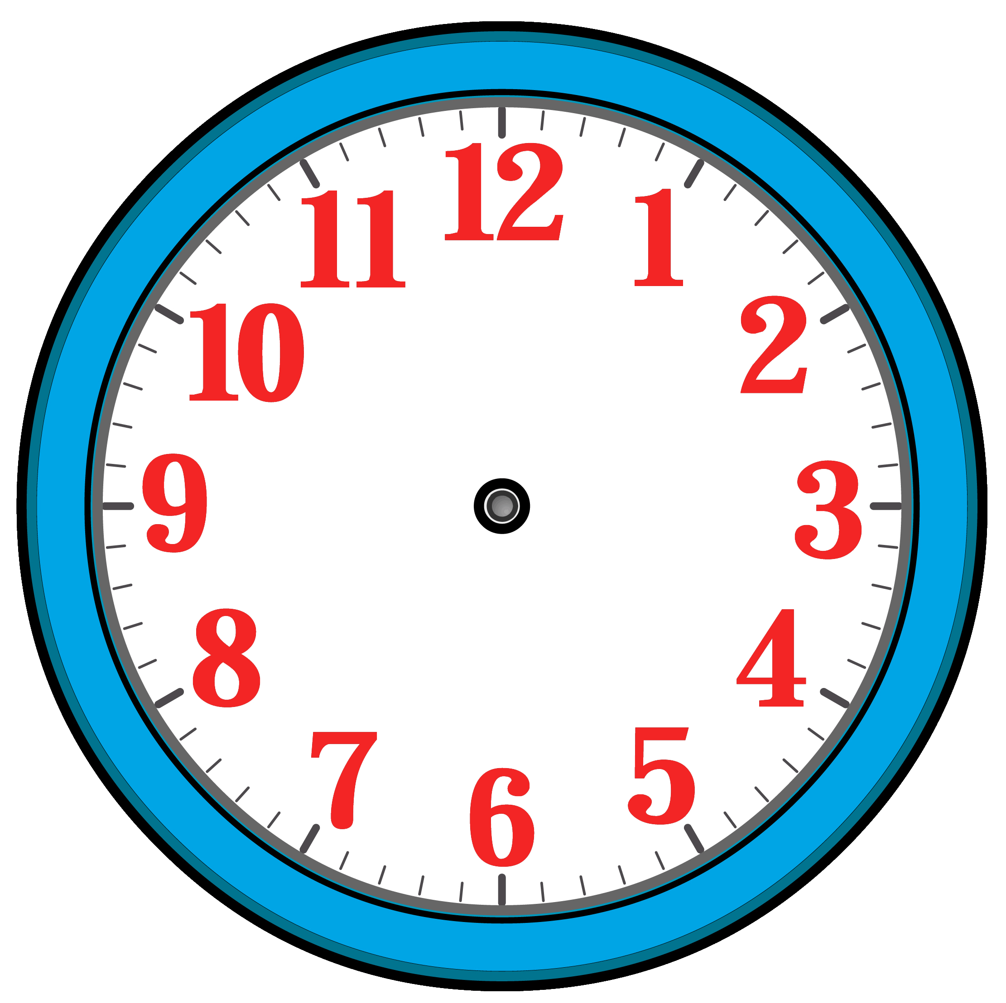
Telling the time
This is a clock face.
The numbers round the clock face are hours.
There are 12 hours marked on the clock.

Slide 3

Telling the time
The lines round the edge are minutes.
There are 60 minutes marked on the clock.
This is because there are 60 minutes in 1 hour.

Slide 4



Telling the time
The small hand points to the hours.
The big hand points to the minutes.
When the big hand points to 12 the time is o’clock.

Slide 5


Telling the time
When the big hand moves from the 12 to the 3 it is quarter past the hour.
This is because the big hand has moved quarter of the way around the clock face.

Slide 6
Telling the time
When the big hand moves from the 12 to the 6 it is half past the hour.
This is because the big hand has moved half of the way around the clock face.

Slide 7
Telling the time
When the big hand moves from the 12 to the 9 it is quarter to the hour.
This is because the big hand only has quarter of the clock face to move to get to the next o’clock.

Slide 8

Telling the time
Well done!
You’ve all learnt something about telling the time.

